Slide 1

NEWTON’s FIRST
LAW of MOTION

Slide 2
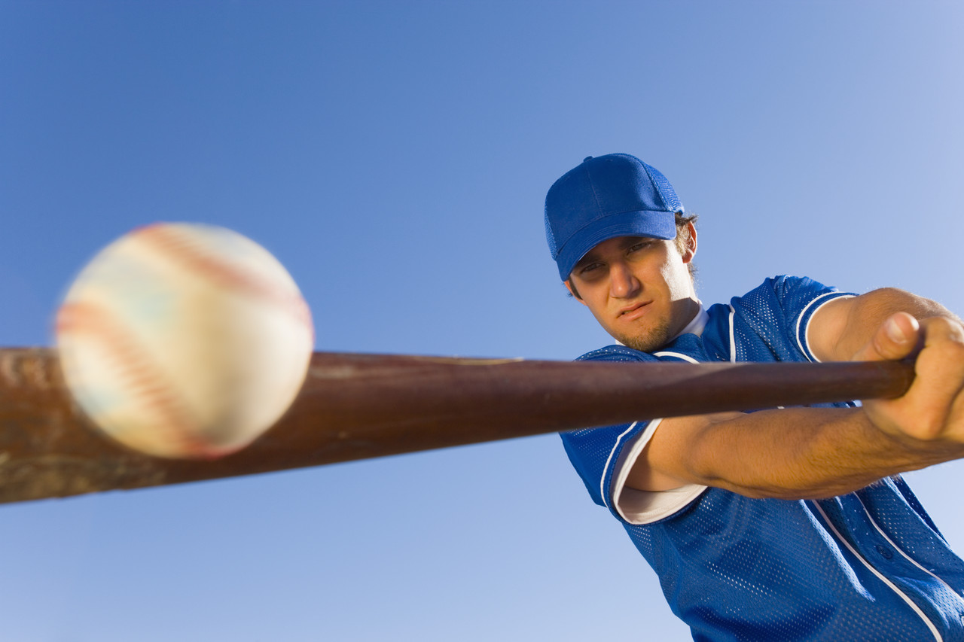
The LAW (#1)
An object at rest remains at rest, and an object in motion remains in motion at the constant speed and in a straight line unless acted on by an unbalanced force.
Notes:
Rather than having students clicking on an external YouTube link, you can record your own video right within the presentation or embed the link onto it’s own slide.
>Add a new slide
>Embed this link
>https://www.youtube.com/watch?v=okCCGxWs_L8

Slide 3
Part 1: Objects at rest
An Object at rest is….
A.) not moving
B.) moving
Notes:
Turn this slide into an interactive quiz.
>
> Go to the MIX tab
> Select Quizzes Videos Apps
> Chose from the following: Free Response Quiz, Multiple Choice quiz, Multiple Response Poll or True/False Quiz

Slide 4

Part 1: Objects at rest
An Object at rest is….
A.) not moving
B.) moving

Slide 5


Objects at rest, such as a chair, desk, book, etc…, will not move by itself unless a force is placed on it.
AHHHH…GHOST!!!

Slide 6

At rest (not moving)
Unbalanced force (moving)

Slide 7


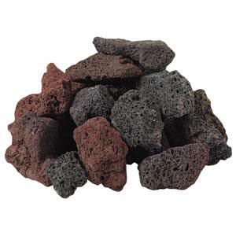
Part 2: Objects in Motion
Moving objects will continue to move forever in the same velocity unless an unbalanced force acts on them.
Notes:
What are some other examples??

Slide 8
KNOWLEDGE check
Scenario…
You are riding a bus to school. When you finished your candy bar, you stand up to walk to the front of the bus.
SUDDENLY, a mouse runs in front of the bus and the bus driver slams on his brakes (he loves mice)…….
What will happen to you?
why?

Slide 9
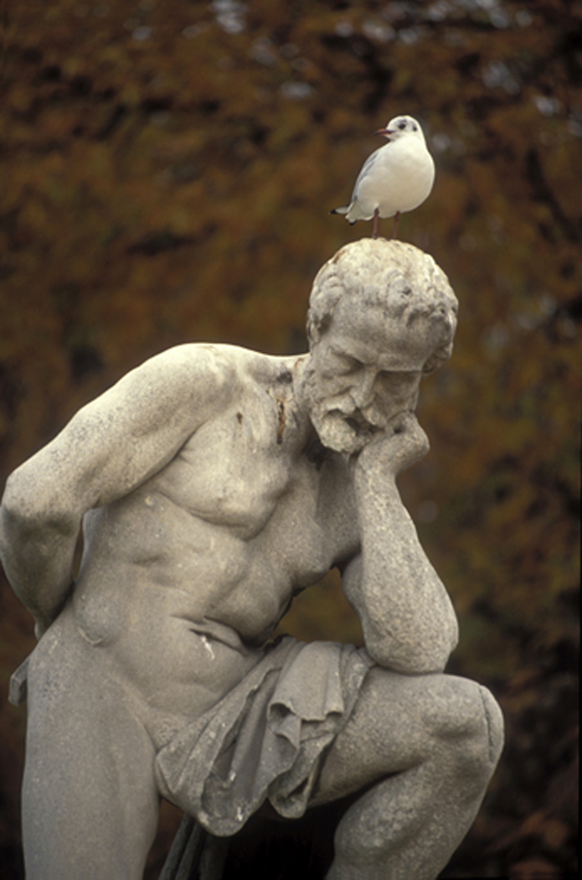
Friction and Newton’s first law
Newton says, “an object in motion will stay in motion forever…unless acted on by a unbalanced force.
If you push your desk, what will happen?
HHmmmm……….

Slide 10
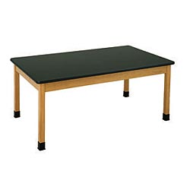

Will it move forever???
What makes it stop?
Preston pushing with all of his strength ☺

Slide 11

FRICTION!!!!
Friction- a force that opposes motion between two surfaces that are in contact.
what if Preston was moving a chair, or a stroller, or a ball?
I forget what friction is!!!!
Kali

Slide 12
Inertia and Newton’s first law
Newton’s first law law of inertia
Inertia- the tendency of an object to resist being moved, or if the object is moving, to resist a change in speed or direction until an outside force acts on the object.
OR
The tendency of an object to resist any changes in motion.
Notes:
Start video at 1:23

Slide 13
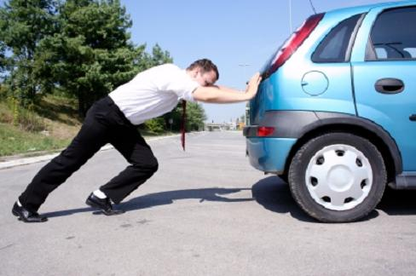
Mass and Inertia
The smaller the mass, the less the inertia
Small/light objects are easier to move, or stop from moving.
Large/heavy objects are harder to move, or stop from moving.

Slide 14
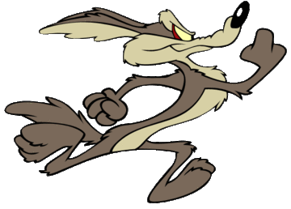
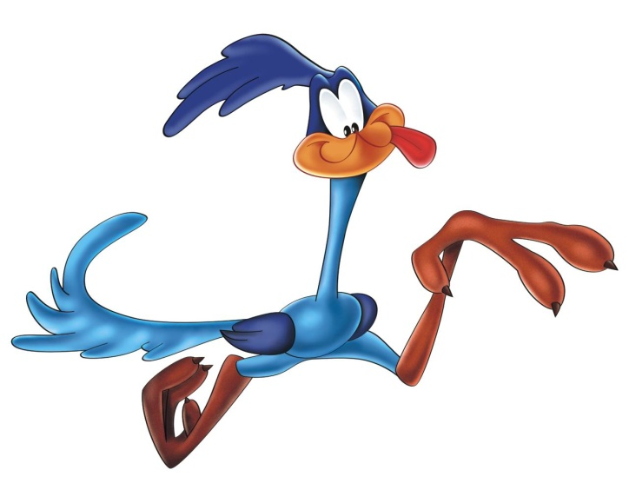
Wile E Coyote
Watch CLIP and write down 3 examples of when Newton’s first law of motion
was demonstrated.
What forces did you notice?

Slide 15
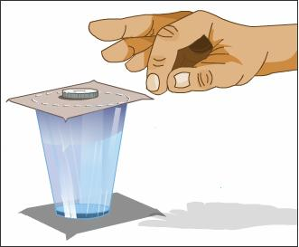
ONE person from each table, get a beaker, a note card, and a penny.
Directions:
Place note card and penny on cup as seen here
Attempt to flick the
card so that the penny
will fall into the beaker.
How does this relate to
Newton’s first law??

